Slide 1
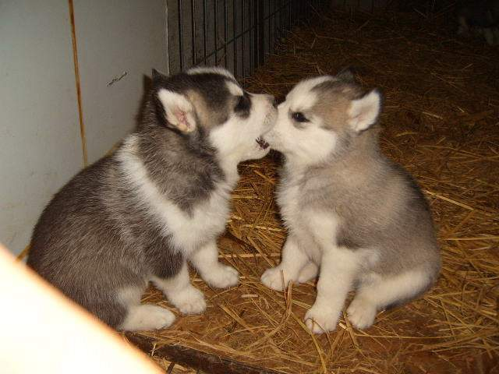
CPR

Slide 2
Definition:
Cardiopulmonary Resuscitation
Cardio = heart
Pulmonary = lungs
Resuscitation = to revive

Slide 3
Terminology
BLS
ALS
CAB
EMS

Slide 4
Good Heart Living
Controllable risk factors
Smoking
Hypertension
Cholesterol
Obesity
Lack of exercise
Stress
Diabetes

Slide 5
Good Heart Living
Uncontrollable risk factors
Age
Sex
Race
Heredity

Slide 6
Symptoms of Heart Attack or Stroke
Heart attack
Pain in chest, arm, neck, back, or jaw
Shortness of breath
Weakness
Feeling faint
Nausea
Unusual perspiration

Slide 7
Symptoms of Heart Attack or Stroke
Stroke
Sudden severe headache
Vision problems
Loss of balance
Confusion
Numbness
Speech problems

Slide 8
First Aid Kits
AED
Face Mask

Slide 9
Minnesota’s Good Samaritan Law
1) Duty to Assist: A person at the scene of an emergency who knows that another person is in physical harm, shall give reasonable assistance to the injured person as long as they are not in danger themselves.
~When you turn 18, it is your legal duty to call 911!
2) General Immunity from Liability: A person who renders emergency care, advice, or assistance without compensation, at the scene of an emergency or during transit is NOT liable for any civil damages.

Slide 10

Links in the adult Chain of Survival:
1) Immediate recognition and activation of emergency response system: call 911
2) Early CPR, w/emphasis on chest compressions
3) Rapid defibrillation (AED)
4) Effective advanced life support
5)Integrated post-cardiac arrest care (new)

Slide 11
CAB’s for Infant ,Child, & Adult
C =Compressions: give 30 at a rate of 100 per minute
A = Airway (open)
Head tilt, chin lift method
Jaw thrust method
B = Breathing (give two mouth to mouth breaths, chest rises)

Slide 12
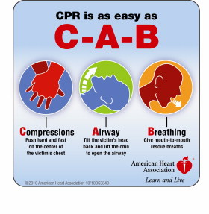

Slide 13
New Guidelines
The new CAB guidelines applies to infants (1-12 months), children (1-8 years) and adults (8 years +)
It does NOT apply to newborns since newborns are usually unconscious due to respiratory complications

Slide 14
Adult CPR
Place heel of one hand on sternum between nipples, cover with other hand interlocking fingers
Give Compressions, push hard and fast in center of chest
1 1/2 to 2 inches @ 100 per minute
Open Airway, give 2 Breaths
Repeat this until help arrives

Slide 15
Child CPR
Use both hands or the heel of one hand on the sternum between nipples; the other hand is placed on the forehead to maintain head tilt
Give 30 Compressions
1 to 1 1/2 inches (1/3 the depth of the chest) @ 100 per minute
Open Airway, give 2 Breaths
Repeat this until help arrives

Slide 16
Infant CPR
Use the tips of 2 fingers on the sternum 1 finger width below the nipples
Give 30 Compressions
1/2 to 1 inch ( 1/3 third depth of the chest) @ at least 100 per minute
Open Airway by breathing over mouth & nose, give 2 Breaths (puffs)
Repeat this until help arrives

Slide 17
Conscious Choking Infant
Call 911
If infant can cough or cry place them in a head down, face down position
DO NOT give any back slaps or compression

Slide 18
Conscious Choking Infant
If there is no sound or sound faint and labored
Give 5 back slaps followed by…
5 chest compressions
Repeat back slaps and chest compressions until object comes out or baby passes out

Slide 19
Unconscious Choking Infant
Check for consciousness
Call 911
Attempt ABC’s
When first breath fails, re-tip and try again

Slide 20
Unconscious Choking Infant
When second attempt fails…
Give 30 chest compressions
Do a foreign object check
Sweep mouth with your pinky ONLY IF OBJECT IS VISIBLE
Attempt to give breath
If breath is unsuccessful repeat this routine beginning with compressions

Slide 21
Conscious Choking Child/Adult: The Heimlich Maneuver
Ask victim if they are choking
If unable to speak, ask if they want the Heimlich maneuver
Call 911
Stand behind them, off-centered
Reaching under their arms place the thumb side of one fist between the navel and the sternum
Cover that fist with your other hand and begin upward, inward thrusts
Continue until object comes out or victim passes out

Slide 22
Unconscious Choking Adult
Check for consciousness
Call 911
Begin ABC’s
If breath attempt fails, re-tip and try again

Slide 23
Unconscious Choking Adult
If second breath fails give 30 CPR style compressions
Check for foreign objects, remove any that are seen
Attempt to give a breath
If breath fails repeat routine beginning with compressions

